Slide 1
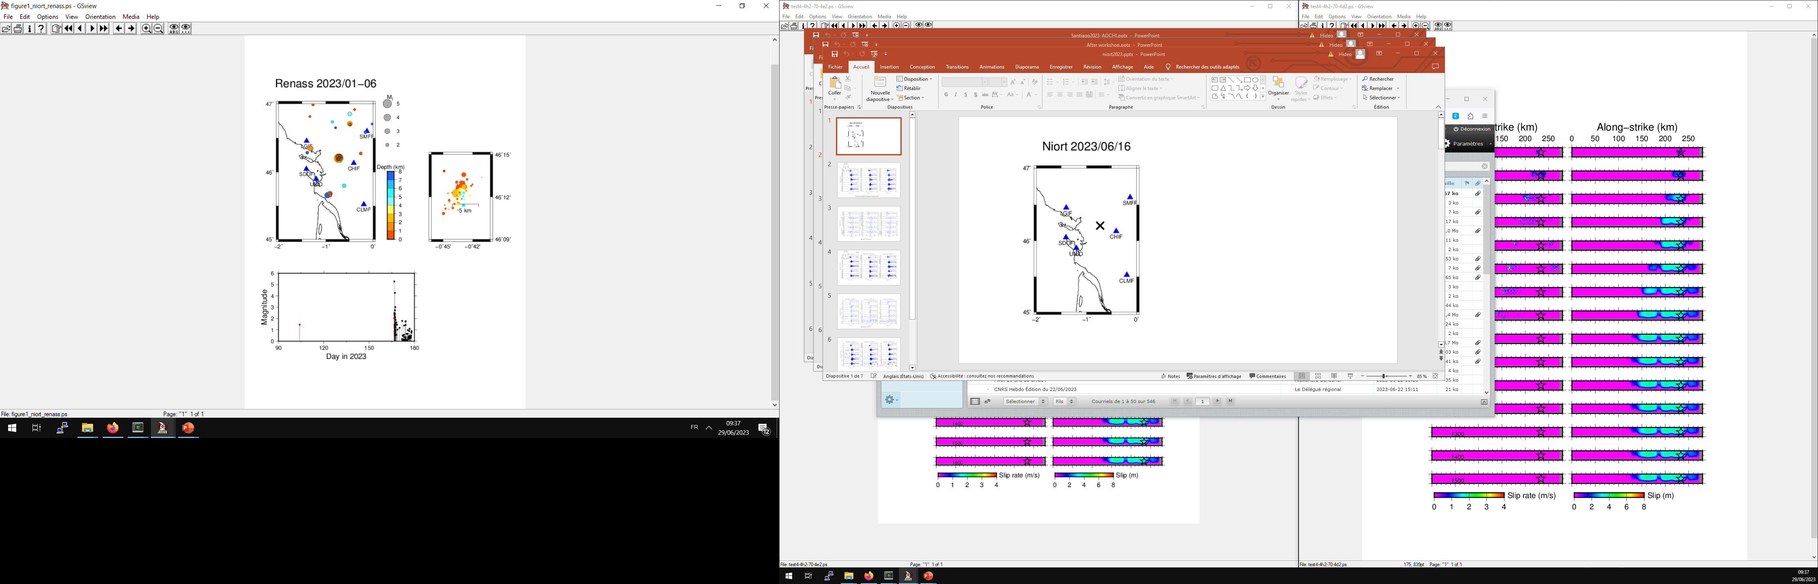
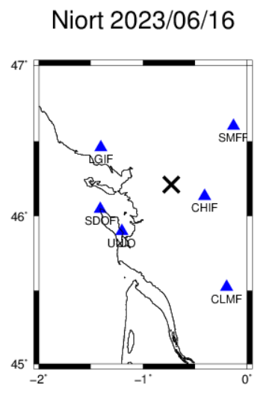

Slide 2
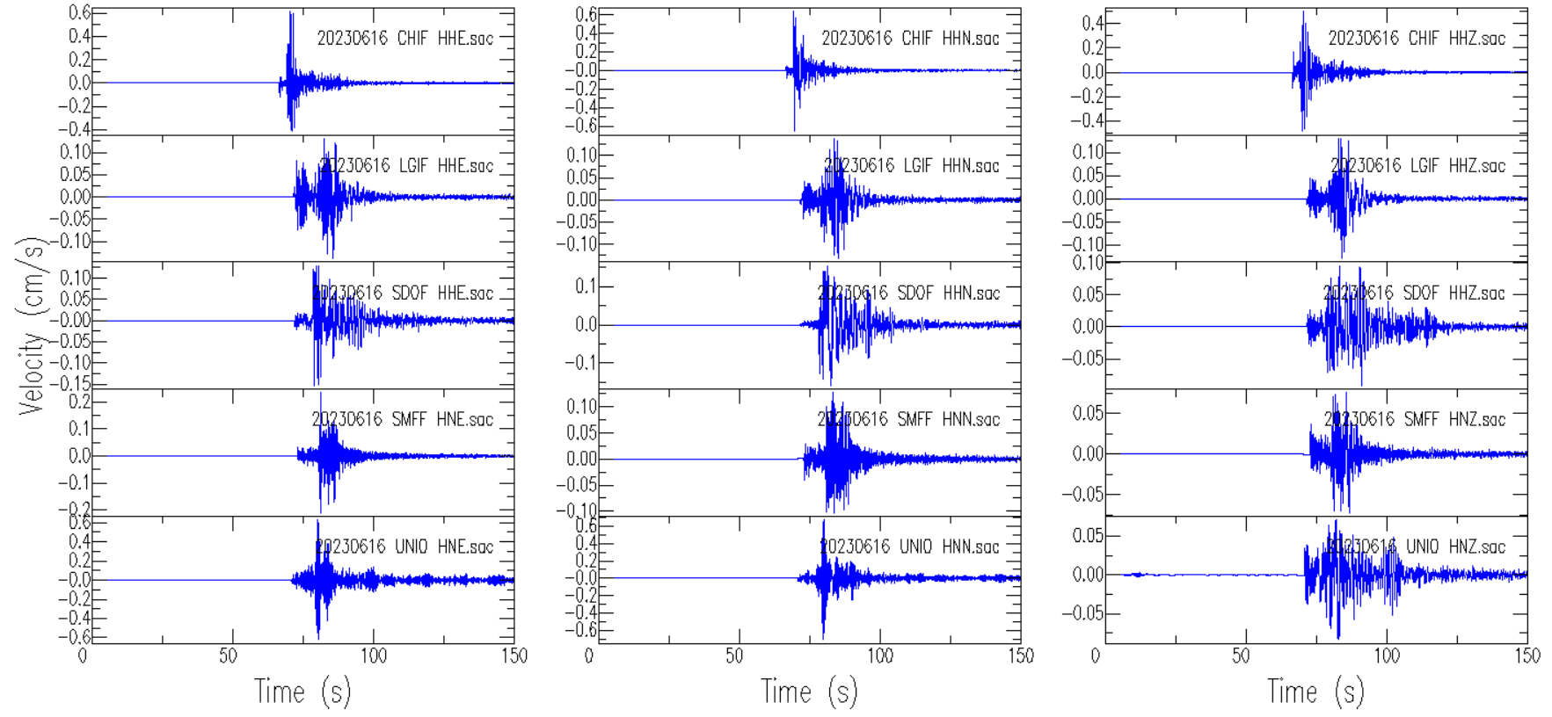
Transfer from polezero freqlimits 0.01 0.05 10 20

Slide 3
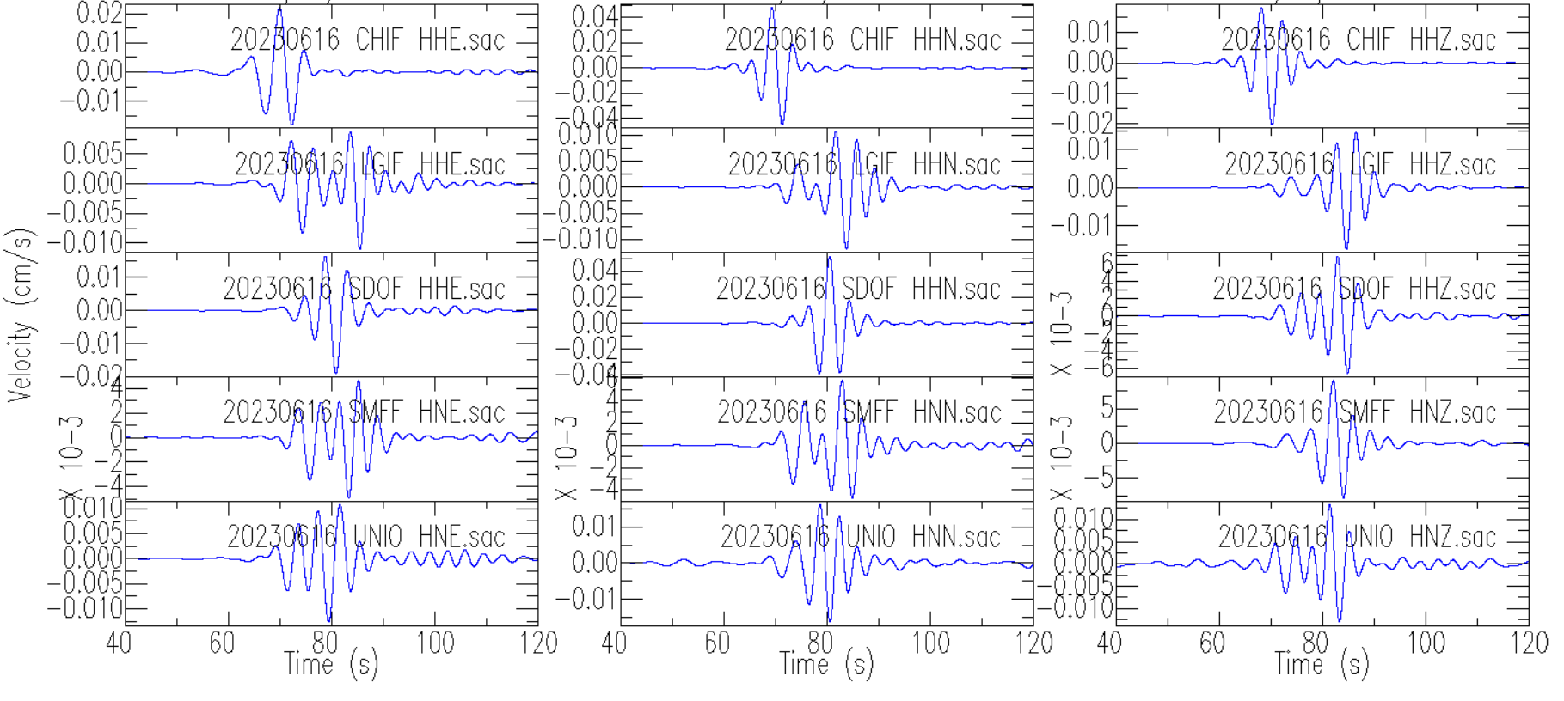
Bp n 4 p c 2 c 0.1 0.3

Slide 4
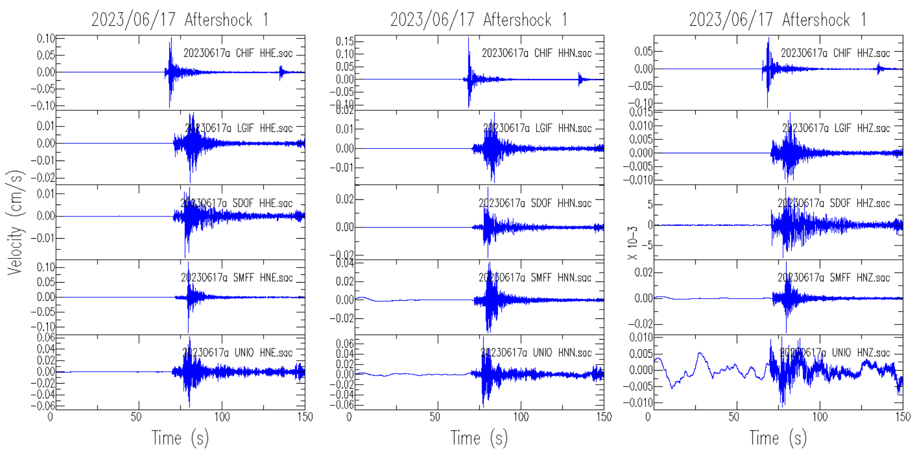
02:26

Slide 5
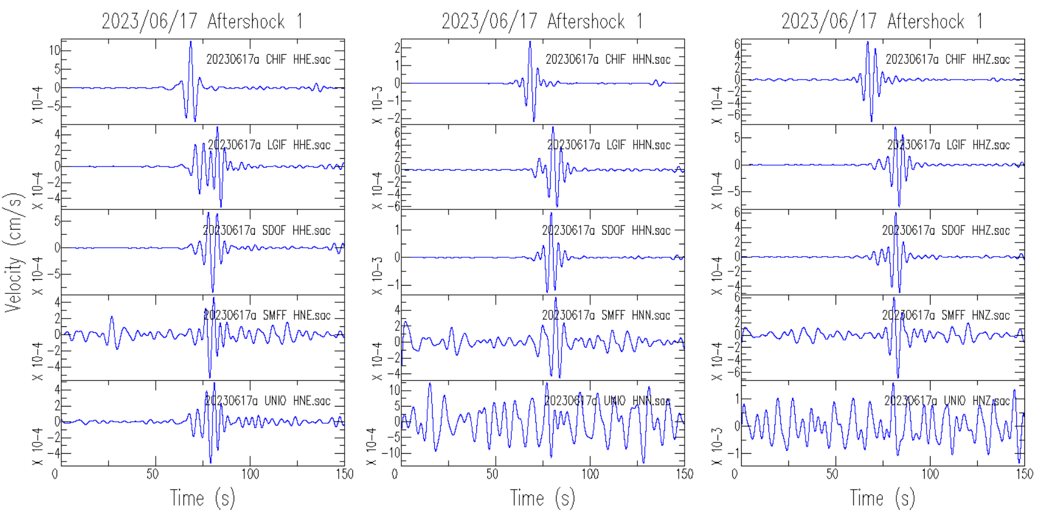
Bp n 4 p c 2 c 0.1 0.3

Slide 6
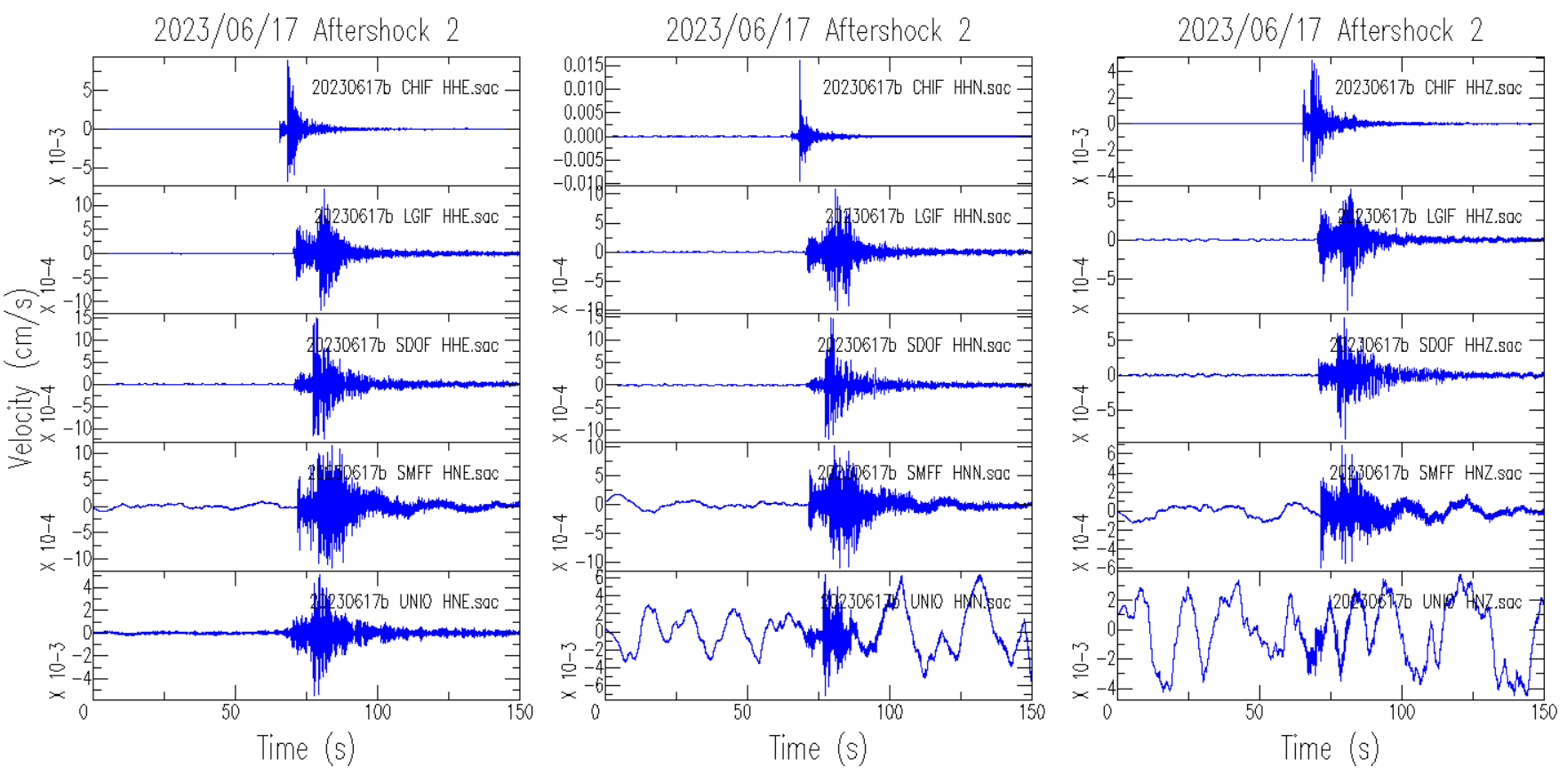

Slide 7
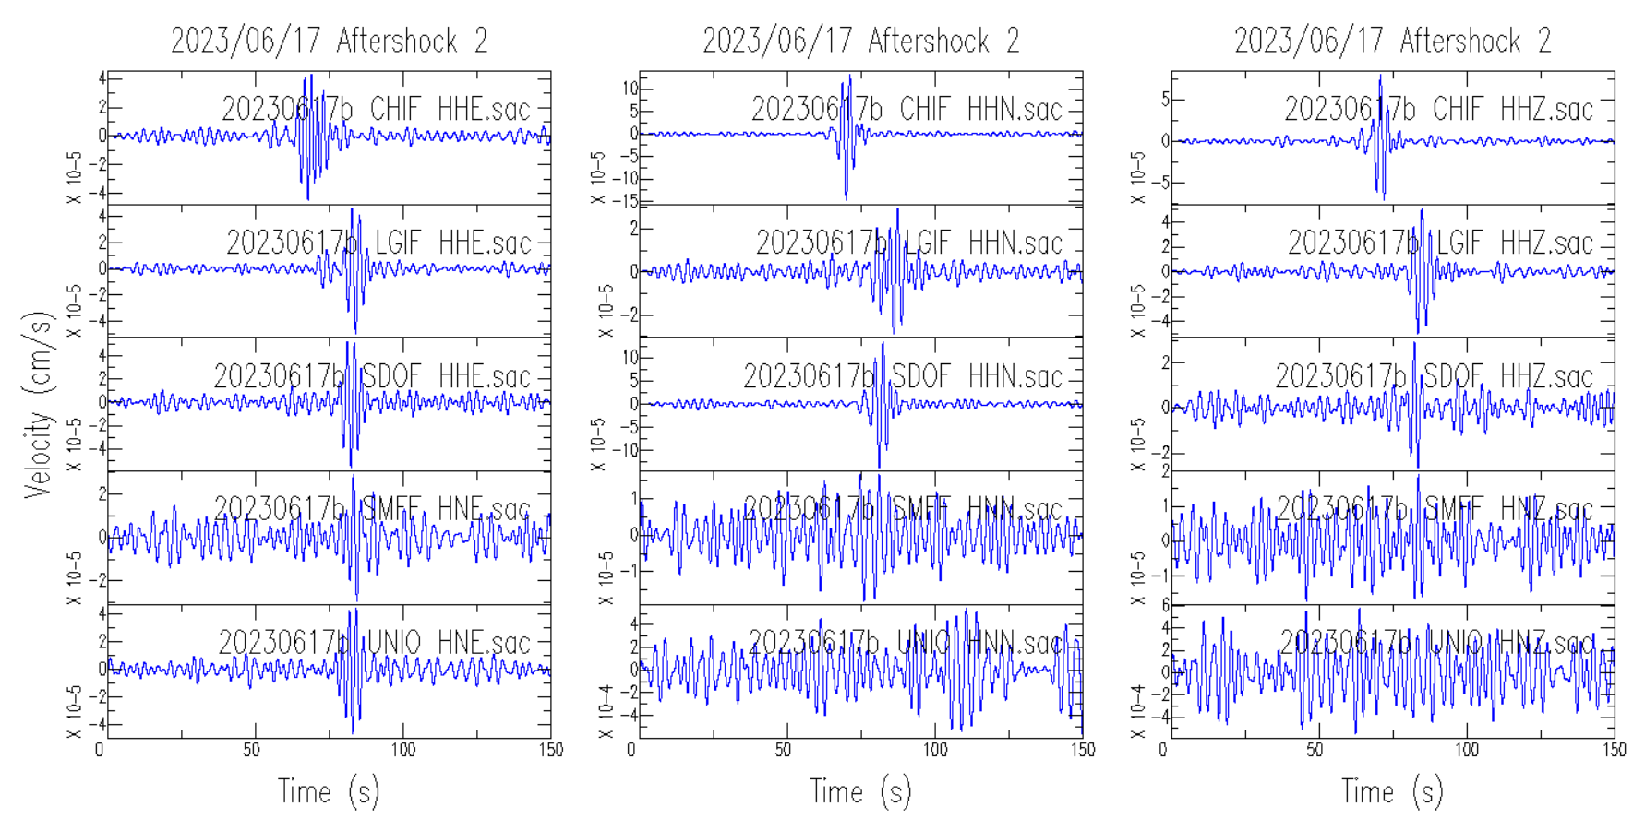
Bp n 4 p c 2 c 0.25 0.5

Slide 8
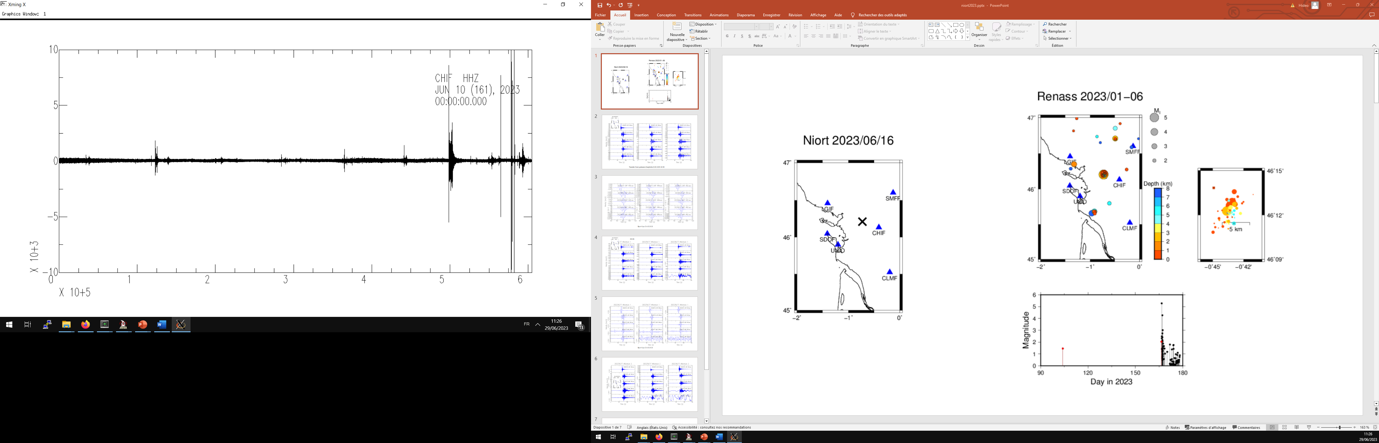
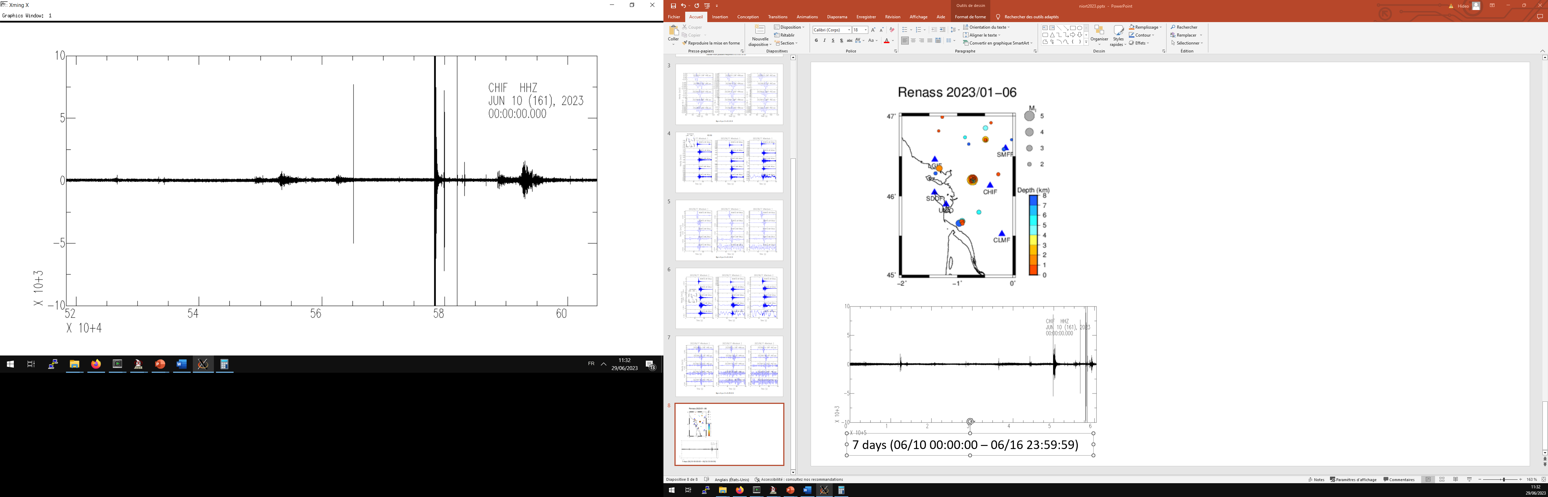
fr2023lznjuc|2023-06-16T16:38:29.882937Z|46.20454788|-0.7273111939|2.658890009|remi.dretzen|Namazu|RENASS|RENASS|MLv|5.27692|
fr2023lzmqha|2023-06-16T12:58:46.329316Z|46.19049072|-0.7155522108|5.304288387|marc.grunberg|Namazu|RENASS|RENASS|MLv|2.040326827|
13h
17h
7 days (06/10 00:00:00 – 06/16 23:59:59)
1 day

Slide 9
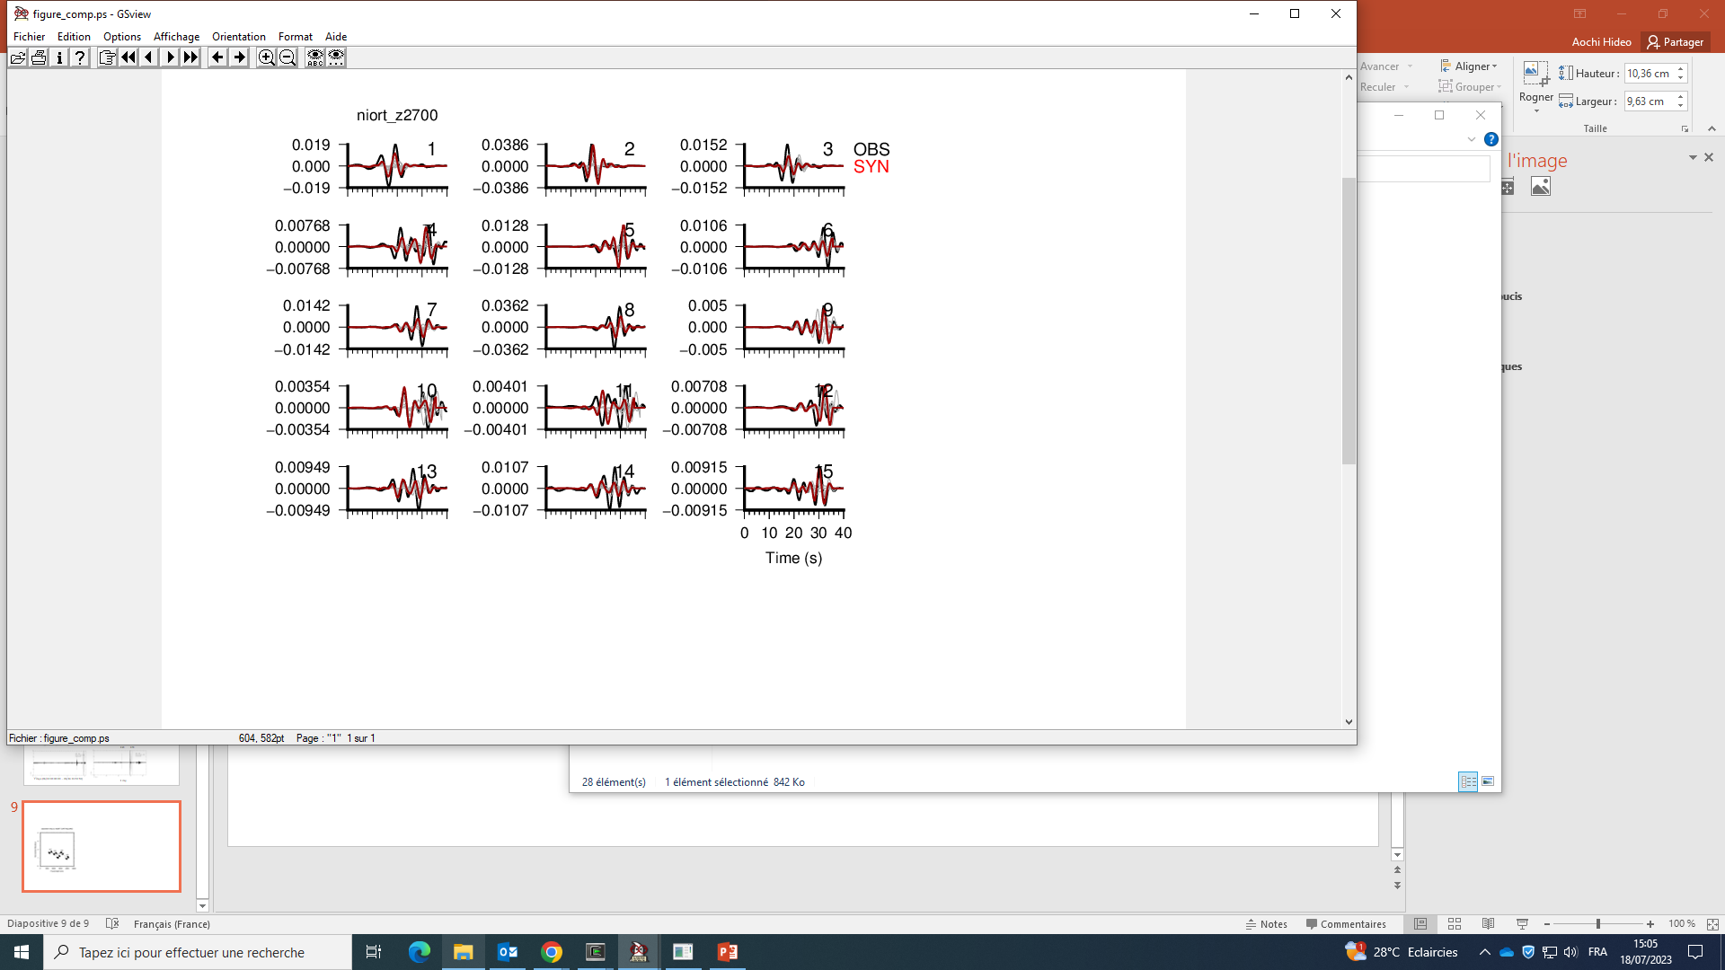
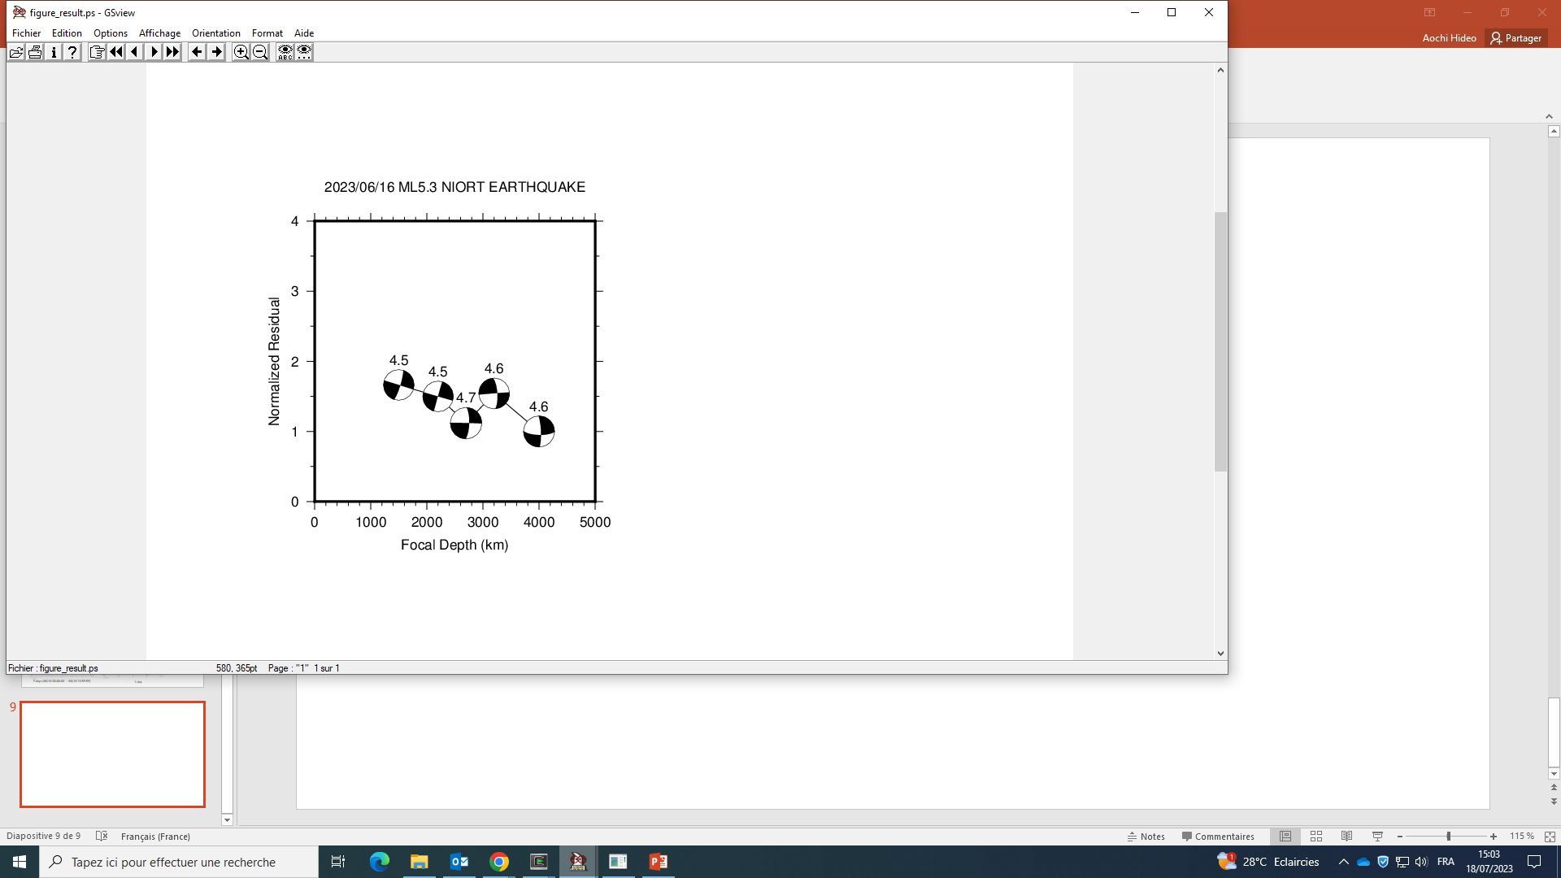
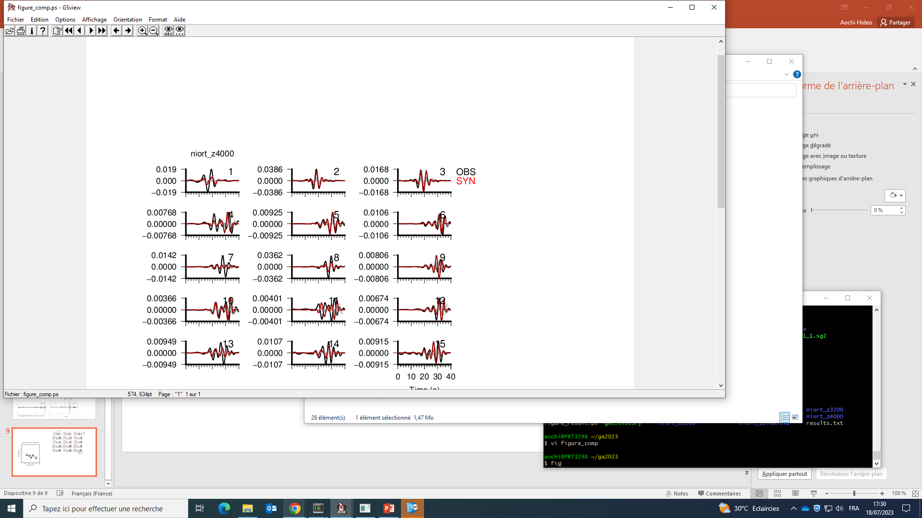
EW, NS, UD
CHIF (BB)
LGIF (BB)
Velocity in m/s
bp c 0.1 0.3
SDOF (BB)
SMFF (acc)
UNIO (acc)
Epicenter position fixed after Rénass (46.2045°N, -07273°E)
Focal depth Rénass

Slide 10
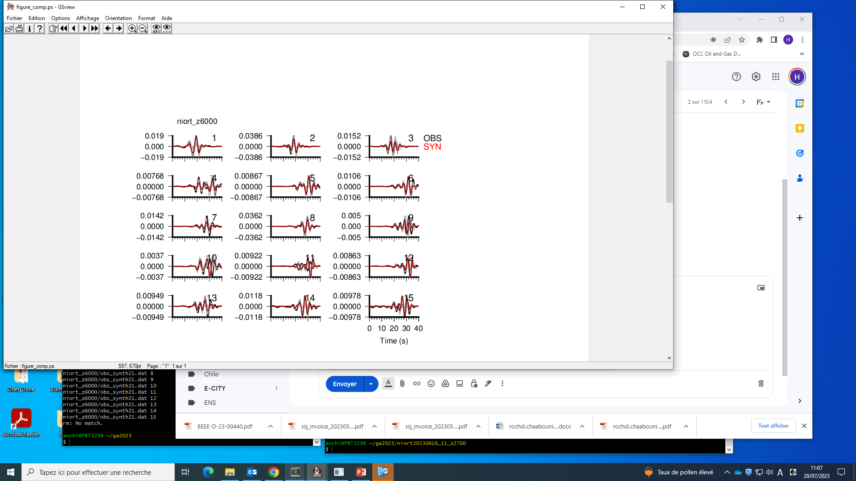
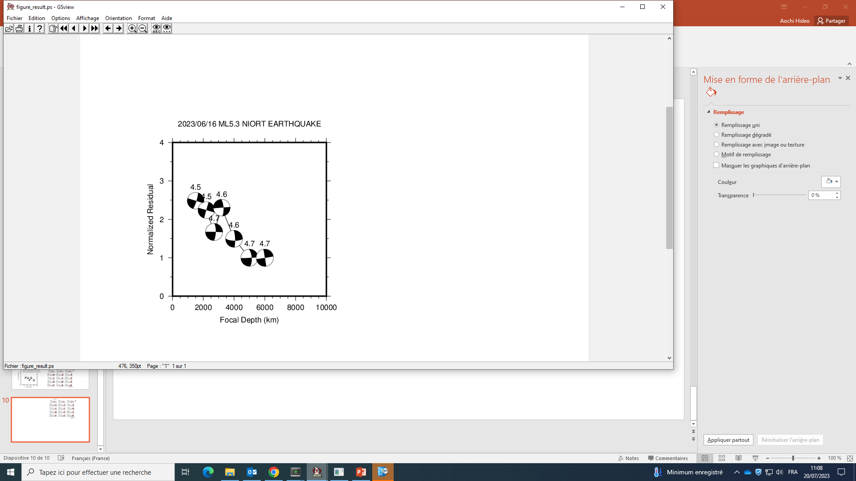
EW, NS, UD
CHIF (BB)
LGIF (BB)
Velocity in m/s
bp c 0.1 0.3
SDOF (BB)
SMFF (acc)
UNIO (acc)
Poorly known structure
Z(km) Vp Vs rho Q
0.0 5400 3195 2650 300
-8 5900 3491 2700 300
-16 6400 3787 2750 300
-24 7000 4142 2800 300
-32 7900 4675 2850 300

